Slide 1
Red Black Trees

Slide 2
A red-black tree is a binary search tree in which each node is colored red or black such that
The root is black
The children of a red node are black
Every path from the root to a null node has the same number of black nodes.

Slide 3
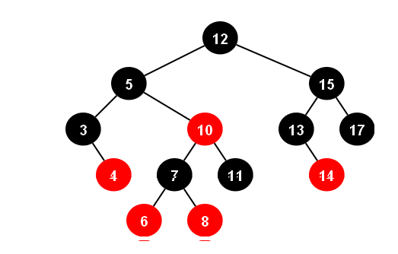

Slide 4


Slide 5


Slide 6
Red black trees do not necessarily have minimum height, but they never get really bad. The height is never greater than log₂(n), where n is the number of nodes.

Slide 7
Black-Height of a Node
h = 4
bh = 2
26
h = 1
bh = 1
h = 3
bh = 2
17
41
NIL
NIL
h = 2
bh = 1
h = 2
bh = 1
30
47
h = 1
bh = 1
38
50
h = 1
bh = 1
NIL
NIL
NIL
NIL
NIL
NIL
Height of a node: the number of edges in the longest path to a leaf
Black-height of a node x: bh(x) is the number of black nodes (including NIL) on the path from x to a leaf,
not counting x

Slide 8
Red Black Trees Operations
Lookup
Insertion
Deletion

Slide 9
Lookup
A red black tree is a BST. Lookup in an RBT is just lookup in a BST. The colors don't matter.

Slide 10
Insertion
The algorithm has three steps:
Insert as you would into a BST, coloring the node red.
If the parent of the node you just inserted was red, you have a double-red problem which you must correct.
Color the root node black.

Slide 11
A double red problem is corrected with zero or more recolorings followed by zero or one restructuring.

Slide 12
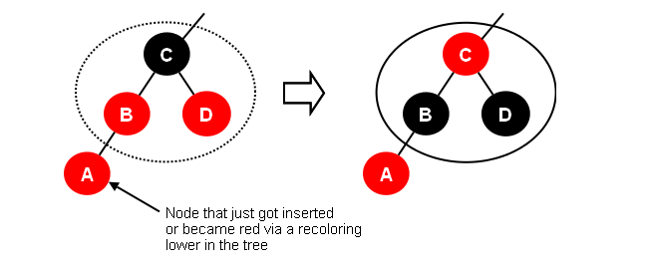
Recoloring Recolor whenever the sibling of a red node's red parent is red:

Slide 13
Restructuring
Restructure whenever the red child's red parent's sibling is black or null. There are four cases:
Right
Left
Right-Left
Left-Right
After restructure, the root of the restructured subtree is colored black and its children are colored red.

Slide 14
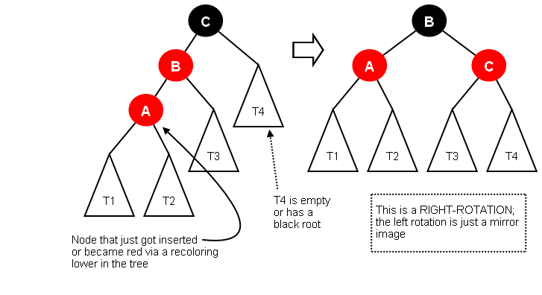

Slide 15
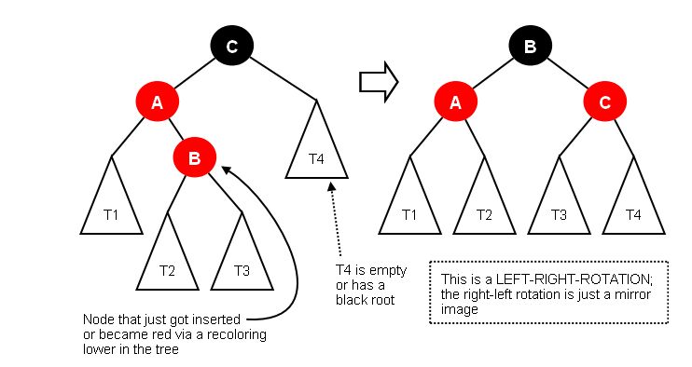

Slide 16
Insertion Cases
Insert node; Color it RED; X is pointer to it
Cases
0: X is the root -- color it black
1: Both parent and uncle are red -- color parent and uncle black, color grandparent red, point X to grandparent, check new situation
2 (zig-zag): Parent is red, but uncle is black. X and its parent are opposite type children -- color grandparent red, color X black, rotate left on parent, rotate right on grandparent
3 (zig-zig): Parent is red, but uncle is black. X and its parent are both left or both right children -- color parent black, color grandparent red, rotate right on grandparent

Slide 17
G
P
U
X
X
S
P
G
Case 2 – Zig-Zag
Double Rotate X around P; X around G
Recolor G and X
S
U

Slide 18
G
P
U
X
X
S
P
G
Case 2 – Zig-Zag
Double Rotate X around P; X around G
Recolor G and X
S
U

Slide 19
G
P
U
S
P
X
X
G
Case 3 – Zig-Zig
Single Rotate P around G
Recolor P and G
S
U

Slide 20
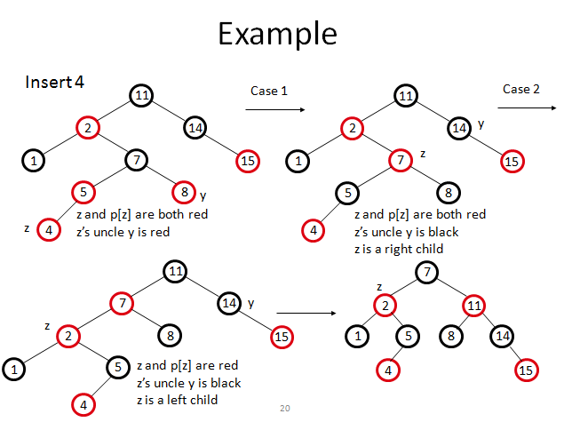

Slide 21
Example
insert into an initially empty red-black tree, the following: 4 7 12 15 3 5 14 18 16 17.

Slide 22
(4B)
(4B (7R))
(4B (7R (12R))) - whoops, need to rotate left ((4R) 7B (12R))
((4R) 7B (12R (15R))) - whoops, need to recolor ((4B) 7B (12B (15R)))
(((3R) 4B) 7B (12B (15R)))
(((3R) 4B (5R)) 7B (12B (15R)))
(((3R) 4B (5R)) 7B (12B ((14R) 15R))) -- whoops, need RL rotation (((3R) 4B (5R)) 7B ((12R) 14B (15R))))
(((3R) 4B (5R)) 7B ((12R) 14B (15R (18R))))) -- whoops, recolor (((3R) 4B (5R)) 7B ((12B) 14R (15B (18R)))))
(((3R) 4B (5R)) 7B ((12B) 14R (15B ((16R) 18R))))) -- whoops, need RL rotation (((3R) 4B (5R)) 7B ((12B) 14R ((15R) 16B (18R))))
(((3R) 4B (5R)) 7B ((12B) 14R ((15R) 16B ((17R) 18R)))) -- whoops, need to recolor (((3R) 4B (5R)) 7B ((12B) 14R ((15B) 16R ((17R) 18B)))) -- whoa, the recolor caused a problem higher up in the tree! -- we need to do a left rotation ((((3R) 4B (5R)) 7R (12B)) 14B ((15B) 16R ((17R) 18B)))

Slide 23
RBTnode class
public class RedBlackTree {
private final int RED = 0;
private final int BLACK = 1;
private class Node {
int key = -1, color = BLACK;
Node left , right , parent;
}
}

Slide 24
private void insert(Node node) {
Node temp = root;
if (root == nil) {
root = node;
node.color = BLACK;
node.parent = nil;
} else {
node.color = RED;
while (true) {
if (node.key < temp.key) {
if (temp.left == nil) {
temp.left = node;
node.parent = temp;
break;
} else {
temp = temp.left;
}
} else if (node.key > temp.key) {
if (temp.right == nil) {
temp.right = node;
node.parent = temp;
break;
} else {
temp = temp.right;
}
}
}
adjustafterinsertion(node);
}
}

Slide 25
public void add(Object data) { if (root == null) { root = new Node(data); } BinaryTreeNode n = root; while (true) { int comparisonResult = compare(data, n.getData()); if (comparisonResult == 0) { n.setData(data); return; } else if (comparisonResult < 0) { if (n.getLeft() == null) { n.setLeft(new Node(data)); adjustAfterInsertion((Node) n.getLeft()); break; } n = n.getLeft(); } else { // comparisonResult > 0 if (n.getRight() == null) { n.setRight(new Node(data)); adjustAfterInsertion((Node) n.getRight()); break; } n = n.getRight(); } } }

Slide 26
private void adjustAfterInsertion(Node n) { // Step 1: Correct double red problems, if they exist
Node uncle= nil; if (n != null && n != root && n.parent==red){
If(n== n.parent.right)
uncle==n.parent.left;
If(n== n.parent.left)
uncle==n.parent.right;
// Step 2a (simplest): Recolor, and move up to see if more work needed if (uncle.color==red) { n.parent.color.=black; uncle.Color=black; n.parent.parent.color=black; adjustAfterInsertion(n.parent.parent); } // Step 2b: Restructure for a parent who is the left child of the grandparent. //this will require a single right rotation if n is also a left child, or a left-right //rotation otherwise. else if (n.parent == n.parent.parent.left) { if (n == n.parnet.right) { rotateLeft(n.parent); } n.parent.Color=black; n.parent.parent.color=red; rotateRight(n.parent.parent); }

Slide 27
// Step 2c: Restructure for a parent who is the right //child of the grandparent. This will require a single left //rotation if n is also a right child, or a right-left rotation //otherwise. else if (n.parent== n.parent.parent.right) { if (n == n.parent.left) { rotateRight(n.parent); } n.parent.Color=black; n.parent.parent.Color=red; rotateLeft(n.parent.parent); } } // Step 3: Color the root black root.Color=black; }

Slide 28
Comparison with AVL Tree
The AVL trees are more balanced compared to Red Black Trees, but they may cause more rotations during insertion and deletion. So if your application involves many frequent insertions and deletions, then Red Black trees should be preferred. And if the insertions and deletions are less frequent and search is more frequent operation, then AVL tree should be preferred over Red Black Tree.

Slide 29
Red Black Tree Deletion
Initially, we will delete a node just like we delete a node in a normal binary search tree. Here are the cases we will look at:
1) Red leaf node
2) Black node, with one red child node
3) Black leaf node
we will only delete nodes with 0 or 1 child. Neither colored node can have one black child. If it did, the black height of the node's null child would not be proper. Further more, a red node can NOT have a red child. These observations narrow the cases to the situations listed above.

Slide 30
Red Leaf Node
In the first case, the normal binary search tree delete is sufficient. Removing a red node does not change the black depths of any node, nor create a red child for any red node.

Slide 31
Black node, with one red child node
In the second case, after we complete the binary search tree delete, we must simply recolor the child node of the deleted node to black. Changing this color adds one to the black depths of each node in the subtree of the deleted node, restoring the equality of the black depths of all external nodes. Also, changing a node to black does not violate any of the other Red-Black Tree specifications.

Slide 32
Black leaf node
Neither of the strategies mentioned above are adequate for dealing with the third case. Instead, when we patch in the child of the deleted node in this case, in order to temporarily preserve the black depth property, we will color this child node a fictitious "double black" color.

Slide 33
